Slide 1

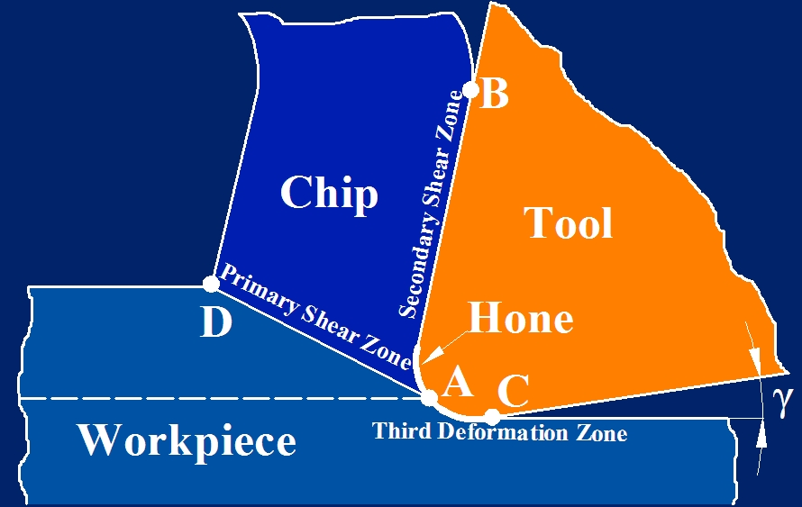
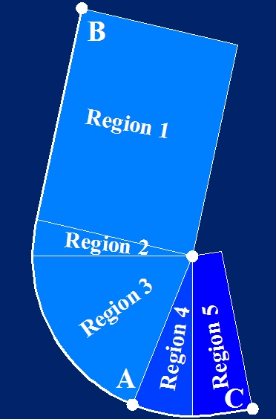
UTIS 2025 13th International Congress on Machining | October 30 - November 3, 2025
Sample Layout for 120 cm x 80 cm Poster: The Title Format
Name Surnameª , Name Surname^{b} , and Name Surname^{c}
a, … University … Faculty …..Department, Izmir/TURKEY, author1@xxx.edu
b, ……. Company, Barcelona/SPAIN, author2@xxx.edu
c, … Research Center, Istanbul/TURKEY, author3@xxx.edu
1. INTRODUCTION
2. DESIGN ISSUES
3. CONCLUSIONS
This layout is to demonstrate the poster for presentation at UTIS 2024. The purpose of poster presentation is to promote informal discussion. It is a graphic display of a written manuscript. The poster presentation stands by itself as a summary of research and usually contains an overview of research objectives, experimental methods, materials, results and a discussion.
Authors are free to choose the fonts, font sizes and colours.
The paper size must be 120 cm x 80 cm.
All the presented material should be read clearly.
The poster should contain the work presented in the submitted manuscript.
Your poster presentation should include:
The paper title and all authors at the top of the poster
A brief introduction, goals, experimental detail, conclusions, and references (make sure this information is presented in a logical and clear sequence)
Explanations for graphs, pictures, and tables.
Poster presentations should be soft-copy (paper/poster) format only should be upload to the submission system
Posters must fit within the designated display area.
The most successful and attractive posters are graphically produced posters that highlight and summarize the main points, with the poster presenter filling in the details.
The entire poster layout should be readable from 2 to 3 meters away.
The least effective poster format is a photocopy of the manuscript.
Figure 1: The hone and the deformation zones in orthogonal cutting .
Figure 2: The regions on the cutting edge used in edge force modeling.

